Slide 1
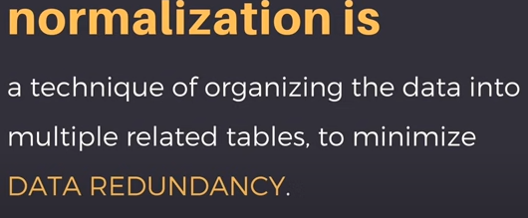
Normalization
5.3

Slide 2
3 Normal Forms Based on Primary Keys
3.1 Normalization of Relations
3.2 Practical Use of Normal Forms
3.3 Definitions of Keys and Attributes Participating in Keys
3.4 First Normal Form
3.5 Second Normal Form
3.6 Third Normal Form
Slide 10- 2
Notes:
2

Slide 3
3.1 Normalization of Relations (1)
Normalization:
The process of decomposing unsatisfactory "bad" relations by breaking up their attributes into smaller relations
Normal form:
Condition using keys and FDs of a relation to certify whether a relation schema is in a particular normal form
Slide 10- 3
Notes:
3

Slide 4
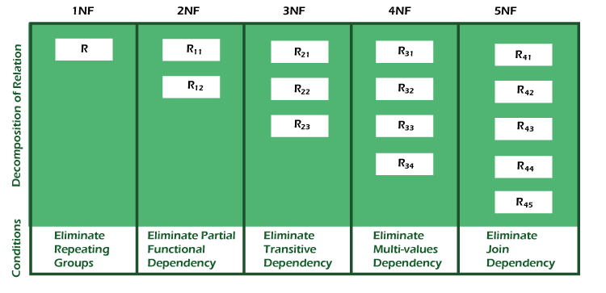

Slide 5
Normalization of Relations (2)
2NF, 3NF, BCNF
based on keys and FDs of a relation schema
4NF
based on keys, multi-valued dependencies : MVDs; 5NF based on keys, join dependencies : JDs (Chapter 11)
Additional properties may be needed to ensure a good relational design (lossless join, dependency preservation; Chapter 11)
Slide 10- 5
Notes:
5

Slide 6
3.2 Practical Use of Normal Forms
Normalization is carried out in practice so that the resulting designs are of high quality and meet the desirable properties
The practical utility of these normal forms becomes questionable when the constraints on which they are based are hard to understand or to detect
The database designers need not normalize to the highest possible normal form
(usually up to 3NF, BCNF or 4NF)
Denormalization:
The process of storing the join of higher normal form relations as a base relation—which is in a lower normal form
Slide 10- 6
Notes:
6

Slide 7
3.3 Definitions of Keys and Attributes Participating in Keys (1)
A key of a relation schema R = {A1, A2, ...., An} is a set of attributes S subset-of R with the property that no two tuples t1 and t2 in any legal relation state r of R will have t1[S] = t2[S]
Eg: {SSN},{SSN,ENAME}, {SSN,ENAME,SEX}
A key K is a superkey with the additional property that removal of any attribute from K will cause K not to be a superkey any more.
Eg:{SSN,ENAME}, {SSN,ENAME,SEX}
Slide 10- 7
Notes:
7

Slide 8
Definitions of Keys and Attributes Participating in Keys (2)
If a relation schema has more than one key, each is called a candidate key.
One of the candidate keys is arbitrarily designated to be the primary key, and the others are called secondary keys.
Eg: PRIMARY KEY = {SSN}, Secondary Key ={ESSN},
A Prime attribute must be a member of some candidate key
Eg: SSN, PNO of Works-on {SSN,PNO}
A Nonprime attribute is not a prime attribute—that is, it is not a member of any candidate key.
Slide 10- 8
Notes:
8

Slide 9
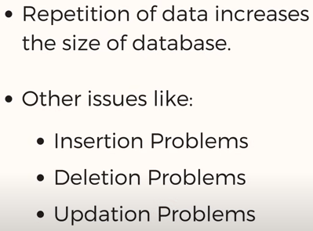

Slide 10
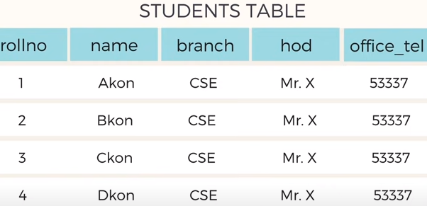
Problems due to redundancy

Slide 11
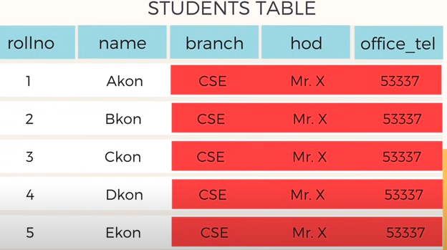
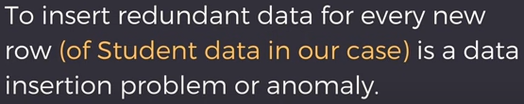
Insertion anomaly

Slide 12
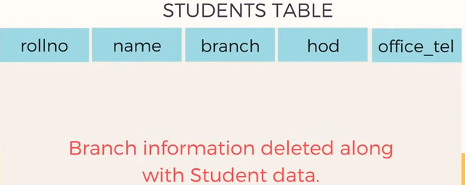
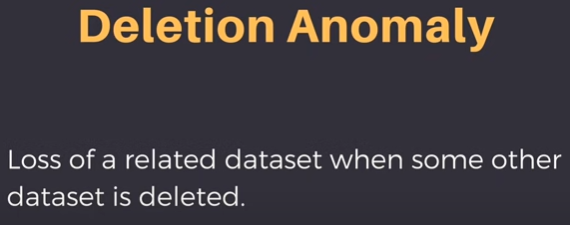
Deletion Anamoly

Slide 13
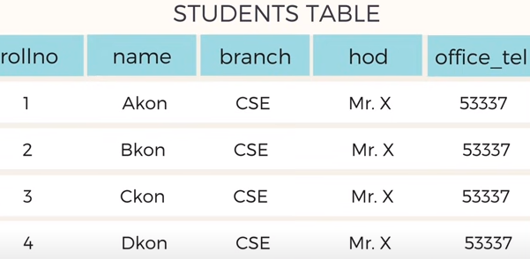

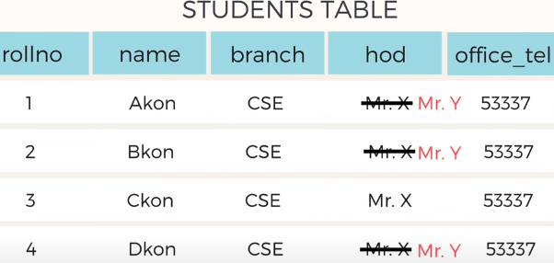
Updation Anamoly
While updating the table, if one
Of the row missed to update,
Data inconsistency can occur.

Slide 14



Slide 15
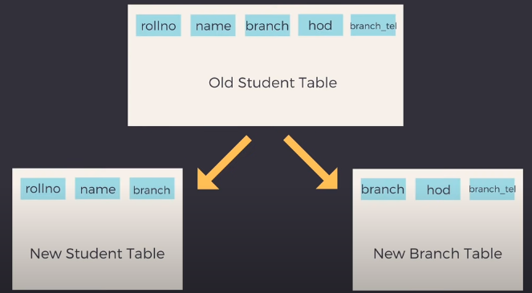

Slide 16
First Normal Form
All the attributes must have atomic values
Disallows
composite attributes
multivalued attributes
nested relations; attributes whose values for an individual tuple are non-atomic
Slide 10- 16
Notes:
16

Slide 17
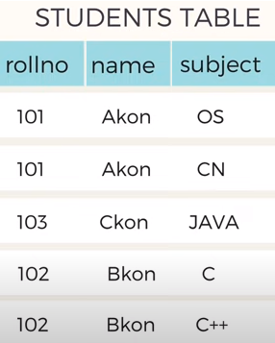
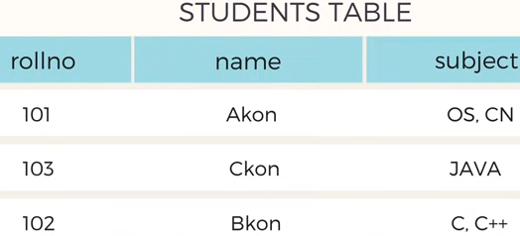
Example
In the student table, subject column is multivalued attribute.
Student table is not in 1NF
Normalize into 1NF

Slide 18
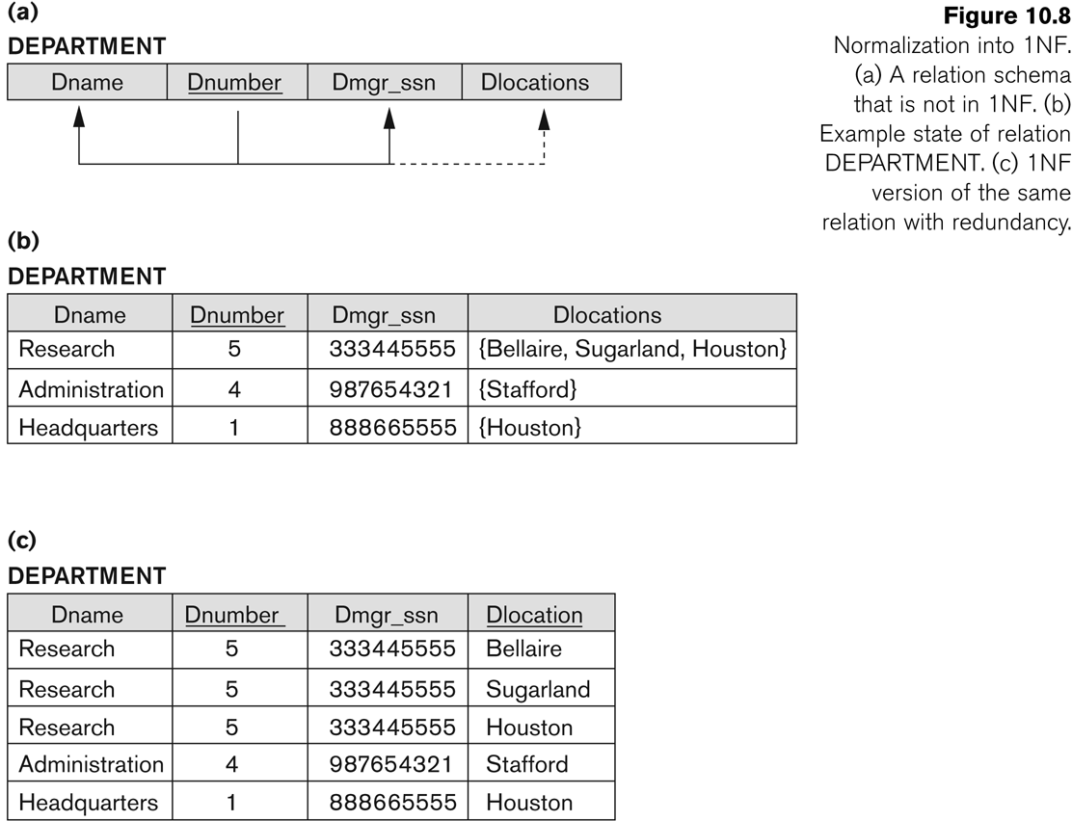
Figure 10.8 Normalization into 1NF
Slide 10- 18
Notes:
18

Slide 19
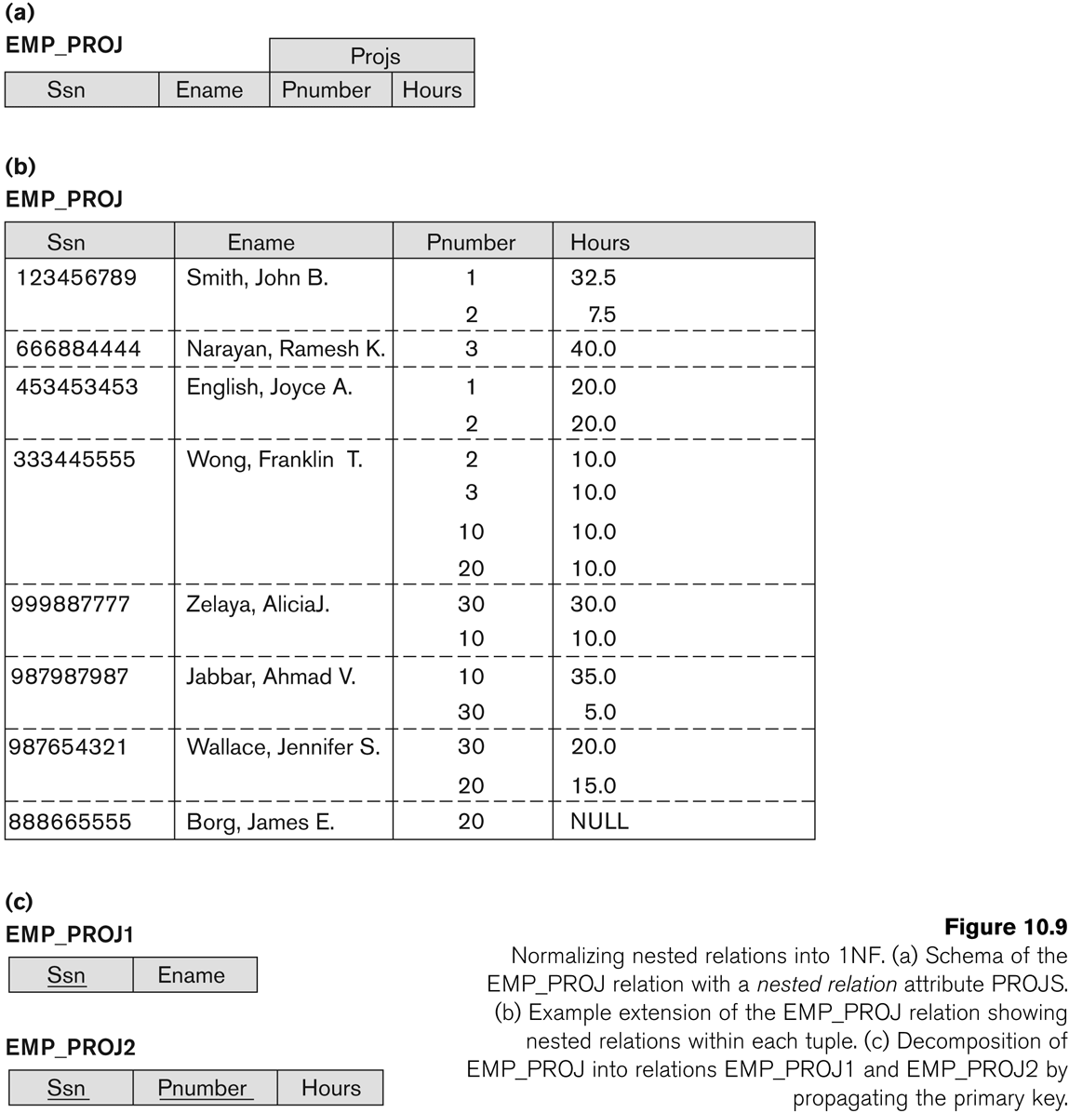
Figure 10.9 Normalization nested relations into 1NF
Slide 10- 19
Notes:
19

Slide 20
Second Normal Form (1)
Uses the concepts of FDs, primary key
Definitions
Prime attribute: An attribute that is member of the candidate key K
Full functional dependency: a FD X -> Y where removal of any attribute from X means the FD does not hold any more
Examples:
{SSN, PNUMBER} -> HOURS is a full FD since neither SSN -> HOURS nor PNUMBER -> HOURS hold
{SSN, PNUMBER} -> ENAME is not a full FD (it is called a partial dependency ) since SSN -> ENAME also holds
Slide 10- 20
Notes:
20

Slide 21
Second Normal Form (2)
A relation should be in 1NF.
A relation schema R is in second normal form (2NF) if every non-prime attribute A in R is fully functionally dependent on the primary key
R can be decomposed into 2NF relations via the process of 2NF normalization .
Slide 10- 21
Notes:
21

Slide 22
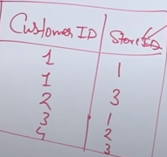
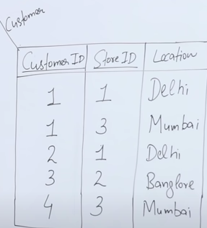

2NF

Slide 23
Example:
Check whether given relation is in 2NF .
R(ABCDEF)
FD: {C 🡪 F, E 🡪A, EC 🡪 D, A 🡪 B}
STEP 1: WHAT IS CANDIDATE KEYS?
CHECK L.H.S
C 🡪 F,
E 🡪A,
EC 🡪 D,
A 🡪 B
EC = {FADB}
Find closure of EC
EC+ =ECFADB
CK ={ EC}
STEP2: PRIME ATTRIBUTES
{E ,C }
NON-PRIME ATTRIBUTES: {A,B,D,F}
CHECK PARTIAL DEPENDANCY
{LHS should be proper subset of CK and RHS should be a non primary key. }
Part of candidate key determines non key attribute.
For C 🡪 F, C is a part od CK and it determines non-key attribute. It is not in 2NF.
E 🡪A, FD
A 🡪 B
Given relation is not in 2NF.

Slide 24
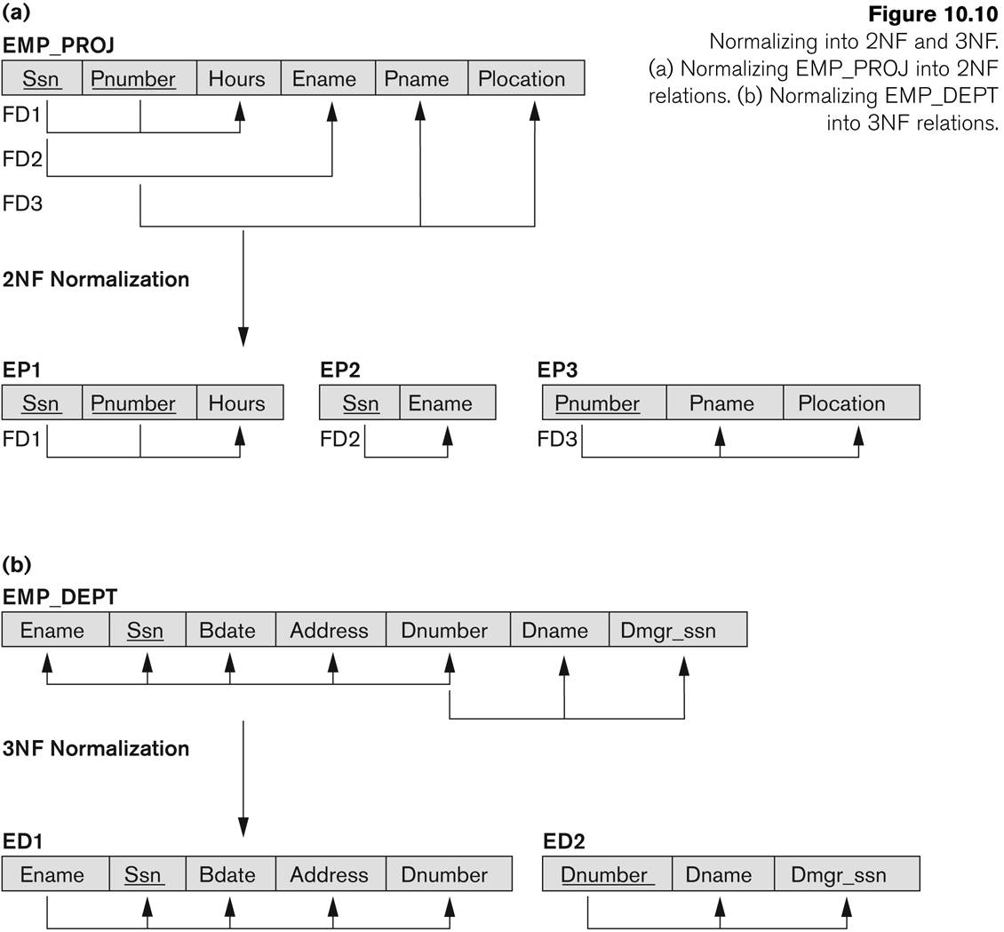
Figure 10.10 Normalizing into 2NF and 3NF
Slide 10- 24
Notes:
24

Slide 25
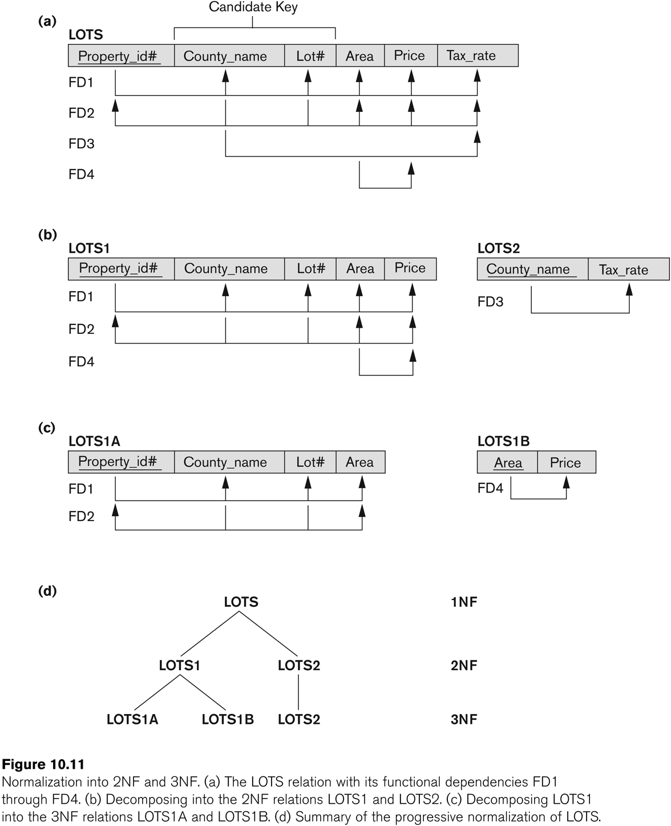
Figure 10.11 Normalization into 2NF and 3NF
Slide 10- 25
Notes:
25

Slide 26
Third Normal Form (1)
Definition:
Transitive functional dependency: a FD X -> Z that can be derived from two FDs X -> Y and Y -> Z
Examples:
SSN -> DMGRSSN is a transitive FD
Since SSN -> DNUMBER and DNUMBER -> DMGRSSN hold
SSN -> ENAME is non-transitive
Since there is no set of attributes X where SSN -> X and X -> ENAME
Slide 10- 26
Notes:
26

Slide 27
Third Normal Form (2)
A relation schema R is in third normal form (3NF) if it is in 2NF and no non-prime attribute A in R is transitively dependent on the primary key
R can be decomposed into 3NF relations via the process of 3NF normalization
NOTE:
In X -> Y and Y -> Z, with X as the primary key, we consider this a problem only if Y is not a part of a candidate key.
When Y is a candidate key, there is no problem with the transitive dependency .
E.g., Consider EMP (SSN, Emp#, Salary ).
Here, SSN -> Emp# -> Salary and Emp# is a candidate key.
Slide 10- 27
Notes:
27

Slide 28
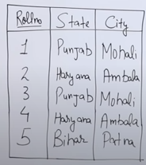
Example 1
Here,
CK/PK :{rollno}
FD: Rollno 🡪 State
State 🡪 City
state is a non-prime attribute, which is trivially dependent.
Given relation is not in 3NF.
Decompose relation as:
Stud(Rollno,City), City(city,state)

Slide 29
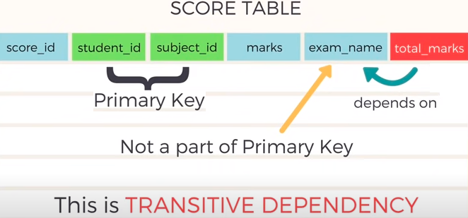
Example 2
Given relation is not in 3NF

Slide 30

Solution:
Split the relation into two relations, such as-

Slide 31
Normal Forms Defined Informally
1st normal form
All attributes depend on the key
2nd normal form
All attributes depend on the whole key
3rd normal form
All attributes depend on nothing but the key
Slide 10- 31
Notes:
31

Slide 32
General Normal Form Definitions (For Multiple Keys) (1)
The above definitions consider the primary key only
The following more general definitions take into account relations with multiple candidate keys
A relation schema R is in second normal form (2NF) if every non-prime attribute A in R is fully functionally dependent on every key of R
Slide 10- 32
Notes:
32

Slide 33
General Normal Form Definitions Third normal form (3NF)
Definition:
Superkey of relation schema R - a set of attributes S of R that contains a key of R
A relation schema R is in third normal form (3NF) if whenever a FD X -> A holds in R, then either:
(a) X is a key of R, or
(b) A is a prime attribute of R
Slide 10- 33
Notes:
33

Slide 34
BCNF (Boyce-Codd Normal Form)
A relation schema R is in Boyce-Codd Normal Form (BCNF) if whenever an FD X -> A holds in R, then X is a superkey of R
In simple terms, for any case (say, X->Y), X can't be a non-prime attribute.
Each normal form is strictly stronger than the previous one
Every 2NF relation is in 1NF
Every 3NF relation is in 2NF
Every BCNF relation is in 3NF
There exist relations that are in 3NF but not in BCNF
The goal is to have each relation in BCNF (or 3NF)
Slide 10- 34
Notes:
34

Slide 35
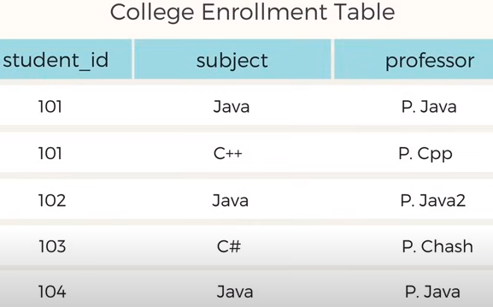
Example

Slide 36
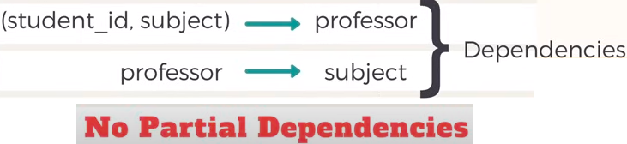
1NF

Slide 37
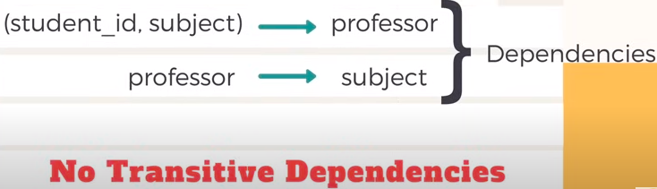
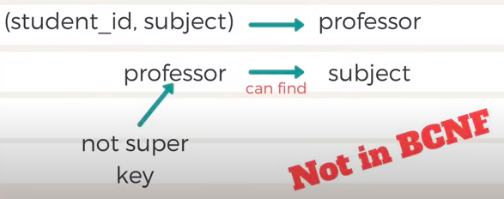
3NF
BCNF

Slide 38
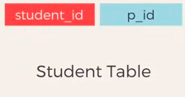
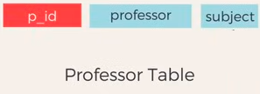
We can decompose the table

Slide 39
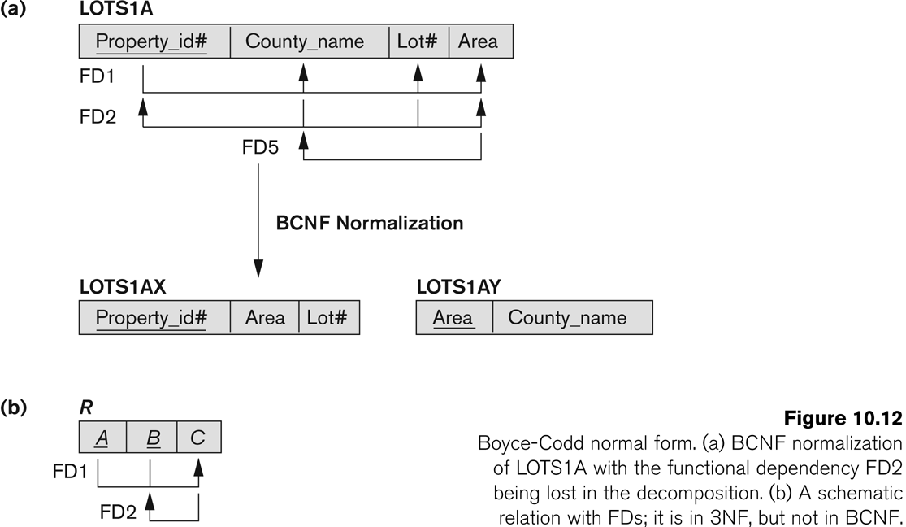
Figure 10.12 Boyce-Codd normal form
Slide 10- 39
Notes:
39

Slide 40
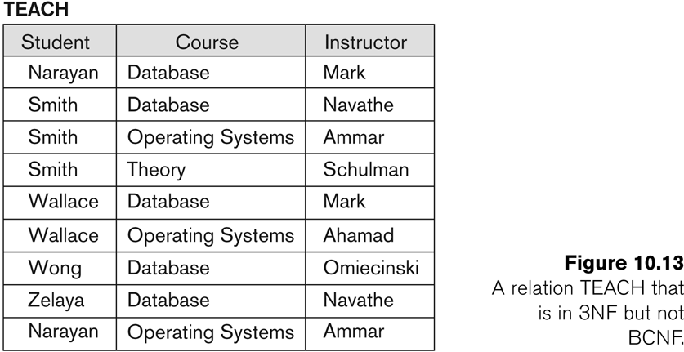
Figure 10.13 a relation TEACH that is in 3NF but not in BCNF
Slide 10- 40
Notes:
40

Slide 41
Achieving the BCNF by Decomposition (1)
Two FDs exist in the relation TEACH:
fd1: { student, course} -> instructor
fd2: instructor -> course
{student, course} is a candidate key for this relation and that the dependencies shown follow the pattern in Figure 10.12 (b).
So this relation is in 3NF but not in BCNF
A relation NOT in BCNF should be decomposed so as to meet this property, while possibly forgoing the preservation of all functional dependencies in the decomposed relations.
(See Algorithm 11.3)
Slide 10- 41
Notes:
41

Slide 42
Chapter Outline
Informal Design Guidelines for Relational Databases
Functional Dependencies (FDs)
Definition, Inference Rules, Equivalence of Sets of FDs, Minimal Sets of FDs
Normal Forms Based on Primary Keys
General Normal Form Definitions (For Multiple Keys)
BCNF (Boyce-Codd Normal Form)
Slide 10- 42
Notes:
42

Slide 43
Achieving the BCNF by Decomposition (2)
Three possible decompositions for relation TEACH
{student, instructor} and {student, course}
{course, instructor } and {course, student}
{instructor, course } and {instructor, student}
All three decompositions will lose fd1.
We have to settle for sacrificing the functional dependency preservation. But we cannot sacrifice the non-additivity property after decomposition.
Out of the above three, only the 3rd decomposition will not generate spurious tuples after join.(and hence has the non-additivity property).
A test to determine whether a binary decomposition (decomposition into two relations) is non-additive (lossless) is discussed in section 11.1.4 under Property LJ1. Verify that the third decomposition above meets the property.
Slide 10- 43
Notes:
43

Slide 44

Fourth Normal Form (4NF)
MULTIVALUED DEPENDANCY
A → B, is multivalued dependency if

Slide 45
3 conditions for Multivalued Dependency
A→B ,for a single value of A, more than one value of B exists.
Tables should have at least 3 columns.
(if table has only 2 columns, we can use 1NF to resolve it).
3. For this table with A,B,C columns, B and C should be independent.
If ALL THE 3 CONDITIONS ARE TRUE, THEN WE CAN SAY THAT THE TABLE MAY HAVE MULTI-VALUED DEPENDENCY.

Slide 46
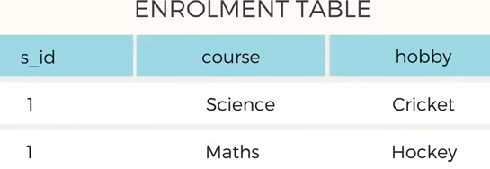
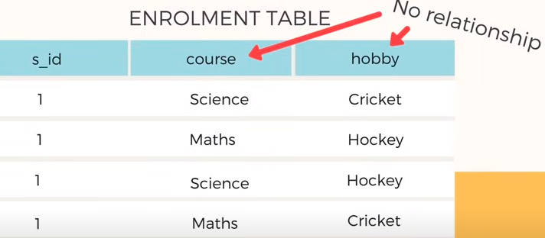
EXAMPLE 1

Slide 47

DECOMPOSITION of the table:

Slide 48
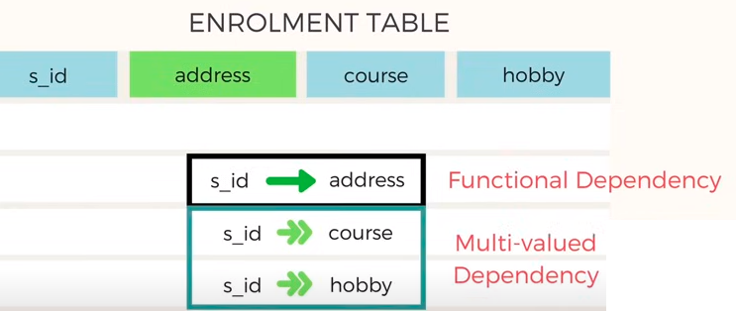

Example 2

Slide 49
Decomposition
The process of decomposition in DBMS helps us remove
redundancy,
Inconsistencies,
anomalies from a database when we divide the table into numerous tables.
In simpler words, the process of decomposition refers to dividing a relation X into {X1, X2,……Xn}.

Slide 50
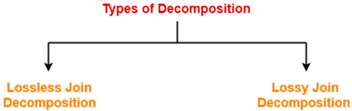
Types of Decomposition
Lossless Join Decomposition (Non-additive):
Consider there is a relation R which is decomposed into sub relations R1 , R2 , …. , Rn.
This decomposition is called lossless join decomposition when the join of the sub relations results in the same relation R that was decomposed.
For lossless join decomposition, we always have
R1 ⋈ R2 ⋈ R3 ……. ⋈ Rn = R, where ⋈ is a natural join operator

Slide 51
Lossy Join Decomposition:
Consider there is a relation R which is decomposed into sub relations R1 , R2 , …. , Rn.
This decomposition is called lossy join decomposition when the join of the sub relations does not result in the same relation R that was decomposed.
The natural join of the sub relations is always found to have some extraneous tuples.
For lossy join decomposition, we always have-
R1 ⋈ R2 ⋈ R3 ……. ⋈ Rn ⊃ R, where ⋈ is a natural join operator

Slide 52
Determining Whether Decomposition Is Lossless Or Lossy
Consider a relation R is decomposed into two sub relations R1 and R2. Then,
If all the following conditions satisfy, then the decomposition is lossless.
If any of these conditions fail, then the decomposition is lossy.
Condition-01
Union of both the sub relations must contain all the attributes that are present in the original relation R.
Thus, R1 ∪ R2 = R

Slide 53
Cntd…
Condition-02
Intersection of both the sub relations must not be null.
In other words, there must be some common attribute which is present in both the sub relations.
Thus, R1 ∩ R2 ≠ ∅
Condition-03
Intersection of both the sub relations must be a super key of either R1 or R2 or both.
Thus, R1 ∩ R2 = Super key of R1 or R2

Slide 54
Properties of Decomposition
Lossless:
All the decomposition that we perform in Database management system should be lossless.
All the information should not be lost while performing the join on the sub-relation to get back the original relation. It helps to remove the redundant data from the database.
Dependency Preservation:
Dependency Preservation is an important technique in database management system.
It ensures that the functional dependencies between the entities is maintained while performing decomposition.
It helps to improve the database efficiency, maintain consistency and integrity.
Lack of Data Redundancy:
Data Redundancy is generally termed as duplicate data or repeated data.
This property states that the decomposition performed should not suffer redundant data.
It will help us to get rid of unwanted data and focus only on the useful data or information.

Slide 55
Dependency preservation example

